Slide 1
Internet Applications
Application Layer Protocols
&
Basics of Network Security

Slide 2
Application Layer
Closest to the end user.
Application layer protocols help exchange data between programs running on the source and destination hosts.
The TCP/IP application layer performs the functions of the upper three layers of the OSI model.
Common application layer protocols include HTTP, FTP, TFTP(Trivial FTP), DNS.

Slide 3
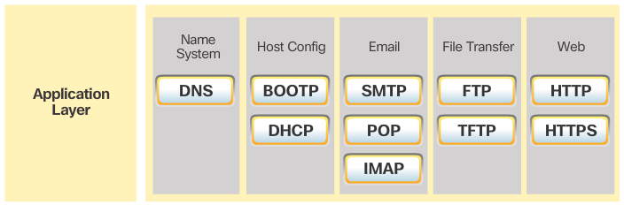
Application Layer Protocols
Internet Applications
TCP/IP Application Layer Protocols
TCP/IP application protocols specify the format and control information necessary for common Internet functions.
Application layer protocols must be implemented in both the source and destination devices.
Application layer protocols implemented on the source and destination host must be compatible to allow communication
DNS: Domain Name System, BOOTP: Bootstrap Protocol, DHCP: Dynamic Host Configuration Protocol, SMTP: Simple Mail Transfer Protocol, POP: Post Office Protocol, IMAP: Internet Message Access Protocol, FTP: File Transfer Protocol, TFTP: Trivial File Transfer Protocol, HTTP: Hypertext Transfer Protocol, HTTPS: Hypertext Transfer Protocol Secure

Slide 4
Internet Applications
INTERNET APPLICATIONS

Slide 5
Internet Applications
Internet Applications
We will cover
Besides these…
Domain Name Service
→ DNS
Proxy Service
→Squid Proxy, Apache Proxy Server
Mail Service
→SMTP, POP, IMAP
Web Service
→ HTTP, HTTPS
SL | Application
File Sharing Service | FTP, BitTorrent
Remote Access Service | Telnet, SSH, RDP
Streaming Service | YouTube, Netflix, Spotify
VoIP Service | Skype, Zoom, WhatsApp
Instant Messaging Service | WhatsApp, Slack, Microsoft Teams
Online Gaming Service | Xbox Live, Steam, PlayStation Network
Cloud Storage Service | Google Drive, Dropbox, OneDrive
Social Networking Service | Facebook, Twitter, LinkedIn
E-commerce Service | Amazon, eBay, Alibaba
Search Engine Service | Google Search, Bing, DuckDuckGo
VPN Service | NordVPN, ExpressVPN

Slide 6
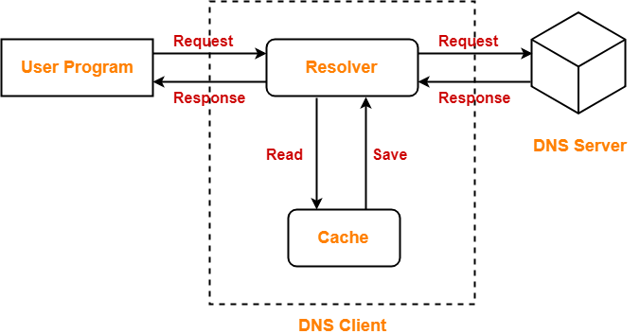
DNS
DNS
DNS is short for Domain Name Service or Domain Name System.
DNS is a host name to IP Address translation service
It converts the names we type in our web browser address bar to the IP Address of web servers hosting those sites
The following diagram illustrates the process of DNS resolution-

Slide 7
DNS Operation
DNS Setup
A DNS server maintains the name to IP address mapping of the domain for which it is the name server.
The DNS server for a domain is registered with the domain registrar and the entry is maintained by the Internet Root-Servers or Country Level Root-Servers.
Whenever a server is asked, if doesn’t have the answer, the root servers are contacted.
The root servers refer to the DNS server for that domain (in case the domain is a top-level domain) or the Country Root Server (in case the domain is country level domain).

Slide 8
Proxy Server
PROXY SERVER
In computer networking, a proxy server is a server application or appliance that acts as an intermediary for requests from clients seeking resources from servers that provide those resources
Instead of connecting directly to a server that can fulfill a requested resource (such as: a file or web page), the client directs the request to the proxy server, which evaluates the request and performs the required network transactions.

Slide 9
What is a Web Proxy?
Proxy Server
A proxy is a host which relays web access requests from clients
Used when clients do not access the web directly
Used for security, logging, accounting and performance
browser
proxy
web

Slide 10
What is Web Caching?
Proxy Server
Storing copies of recently accessed web pages
Pages are delivered from the cache when requested again
Browser caches
Proxy caches

Slide 11
Why Cache?
Proxy Server
Shorter response time
Reduced bandwidth requirement
Reduced load on servers
Access control and logging

Slide 12
Popular Proxy Caches
Proxy Server
Apache proxy
MS proxy server
WinProxy
Squid
Squid is popular because it is powerful, configurable and free
Many others

Slide 13
Web Server
WEB SERVER
Web server is a computer where the web content is stored
Basically web server is used to host the web sites but there exists other web servers also such as gaming, storage, FTP, email etc.
When client sends request for a web page, the web server search for the requested page if requested page is found then it will send it to client with an HTTP response.

Slide 14
Web Server
Web Server
HTTP (Hyper Text Transfer Protocol) is used to transfer web pages from a Web Server to Web Client (Browser)
Web Pages are arranged in a directory structure in the Web Server
HTTP supports CGI (Common Gateway interface)
HTTP supports Virtual Hosting (Hosting multiple sites on the same server)
Popular Web Servers
Apache
Windows IIS
IBM Websphere

Slide 15
Email
EMAIL
SMTP is short for Simple Mail Transfer Protocol.
It is an application layer protocol.
It is used for sending the emails efficiently and reliably over the internet.

Slide 16

Mail Architecture
Email
Internet
Mail Server
Mail Server
Mail Client
Mail Client

Slide 17
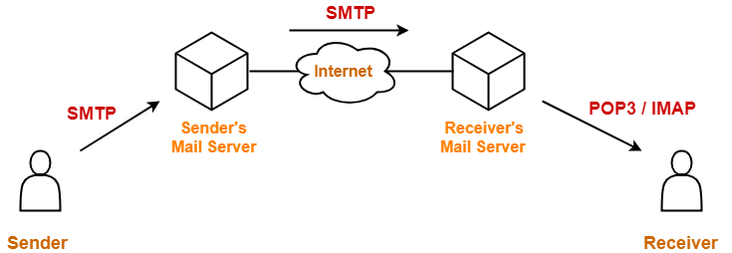
Mail Architecture
Email

Slide 18
Network Security
Network Security

Slide 19
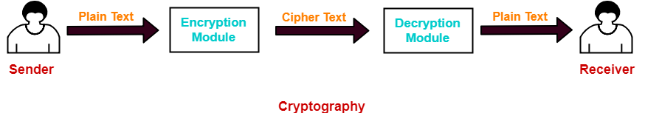
Network Security
Network Security
Cryptography comes from Greek words for “secret writing”
Cryptography is a method of storing and transmitting data in a particular form.
It ensures that only the person for whom the message is intended can read the message.
The message exchange using cryptography involves the following steps-

Slide 20
Network Security
Network Security
At sender side,
Using an encryption algorithm, the message is converted into an unreadable form.
The message in unreadable form is called as cipher text
At Receiver side,
Using a decryption algorithm, the message is again converted into the readable form.
Then, receiver can read the message.

Slide 21

Cryptography Techniques-
Network Security
Cryptography techniques may be classified as-
Symmetric Key Cryptography-
Both sender and receiver uses a common key to encrypt and decrypt the message.
This secret key is known only to the sender and to the receiver.
It is also called as secret key cryptography.
Some of the encryption algorithms that use symmetric key are-
Advanced Encryption Standard (AES)
Data Encryption Standard (DES)

Slide 22
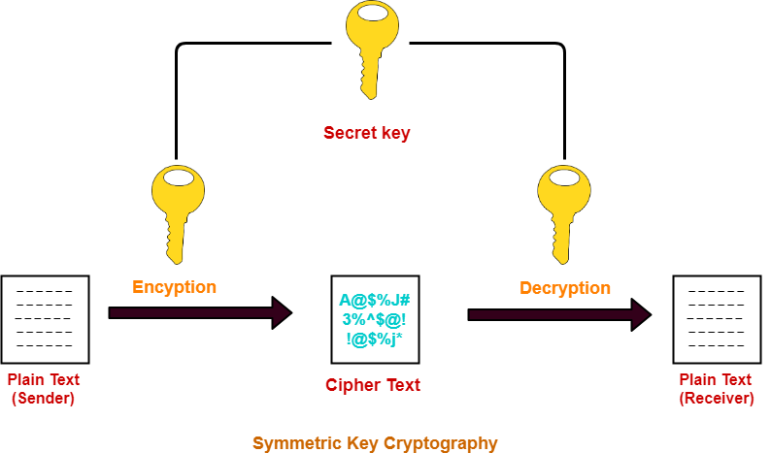
Symmetric Key Cryptography-
Network Security

Slide 23
Asymmetric Key Cryptography-
Network Security
In this technique,
Sender and receiver use different keys to encrypt and decrypt the message.
It is called so because sender and receiver use different keys.
It is also called as public key cryptography.
At sender side,
Sender encrypts the message using receiver’s public key.
The public key of receiver is publicly available and known to everyone.
Encryption converts the message into a cipher text.
This cipher text can be decrypted only using the receiver’s private key.
At receiver side,
Receiver decrypts the cipher text using his private key.
The private key of the receiver is known only to the receiver.
Using the public key, it is not possible for anyone to determine the receiver’s private key.
After decryption, cipher text converts back into a readable format.

Slide 24
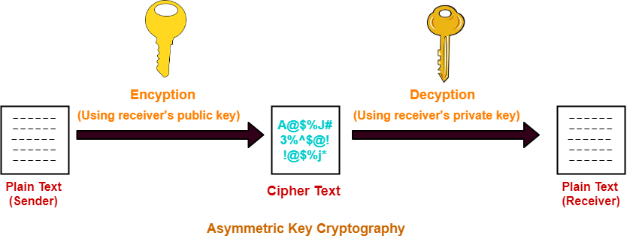
Asymmetric Key Cryptography-
Network Security

Slide 25
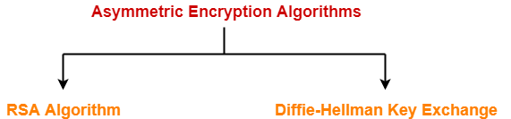
Asymmetric Encryption Algorithms-
Network Security
The famous asymmetric encryption algorithms are-
RSA Algorithm
Diffie-Hellman Key Exchange

